Slide 1
Multivariate Timeseries Analysis with missing data

Slide 2
Problem Statement
Research current methodologies on multivariate timeseries analysis with missing data
Suggest deep RL based approach

Slide 3

Objective
Compare various existing methodologies for analyzing multivariate time series data that contain missing values.
Use various datasets for comparison
Deep RL to capture the complex time series pattern and the dependence between variables.

Slide 4
Requirements
Speed
Stability
Experimenting with deep RL for prediction
Not using external libraries

Slide 5

Citations

Slide 6

Benchmark datasets
UCI Machine Learning Repository
MIMIC-III (The Medical Information Mart for Intensive Care dataset)
Numenta Anomaly Benchmark (NAB)
PhysioNet
Yahoo News Feed
EEG Motor Movement/Imagery Dataset
Kaggle

Slide 7
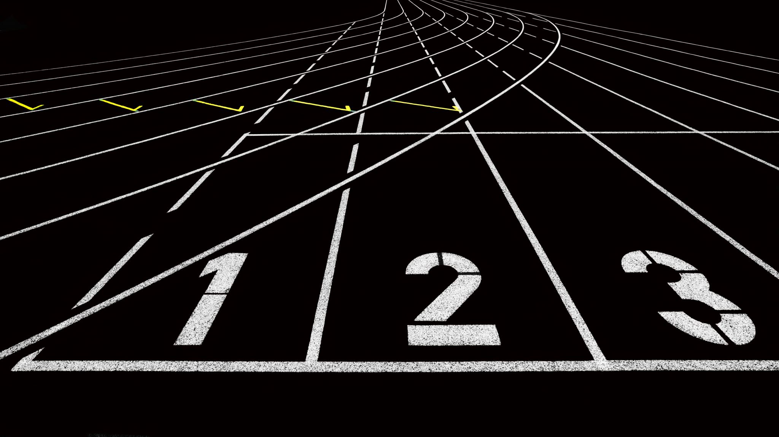
Baseline approaches to compare with

Slide 8
Metrics for comparision

Slide 9
Prediction Algorithm
Feedforward learning data processing model
Prediction improvement using correlation between multiple timeseries
Establish data volume prediction model
Calculate deviation between actual and predicted data

Slide 10
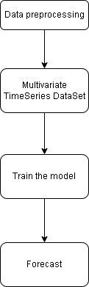
Prediction Algorithm

Slide 12
A Multivariate Time Series consist of more than one time-dependent variable and each variable depends not only on its past values but also has some dependency on other variables.
To deal with MTS, one of the most popular methods is Vector Auto Regressive Moving Average models (VARMA) that is a vector form of autoregressive integrated moving average (ARIMA) that can be used to examine the relationships among several variables in multivariate time series analysis.
Yash P Mehra’s 1994 article: “Wage Growth and the Inflation Process: An Empirical Approach” Dataset link - https://raw.githubusercontent.com/selva86/datasets/master/Raotbl6.csv
The dataset has 123 rows and 8 columns and the definition of columns are shown below.
rgnp : Real GNP.
pgnp : Potential real GNP.
ulc : Unit labor cost.
gdfco : Fixed weight deflator for personal consumption expenditure excluding food and energy.
gdf : Fixed weight GNP deflator.
gdfim : Fixed weight import deflator.
gdfcf : Fixed weight deflator for food in personal consumption expenditure.
gdfce : Fixed weight deflator for energy in personal consumption expenditure.

Slide 13
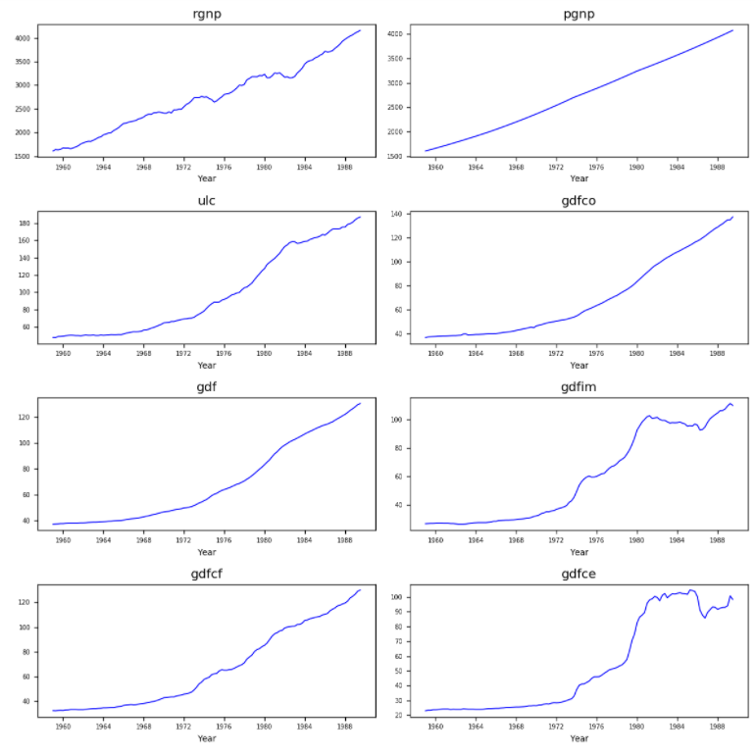
Visualize the data in the figure below and through our observation, all 8 variables has no obvious seasonality and each curve slopes upward.

Slide 14
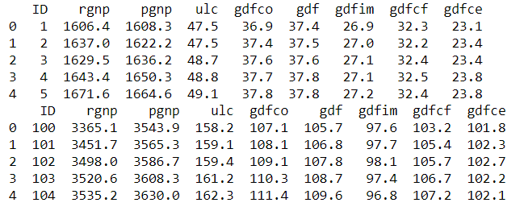
Data Splitting

Slide 15
Model Building
Causality investigation
Test for stationary
Model Building
Test for residuals (errors)

Slide 16
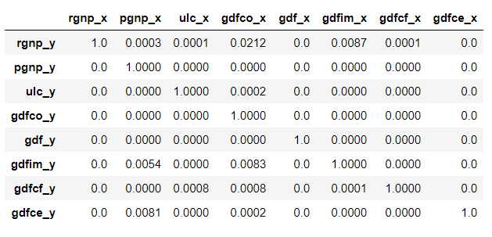
Causality Investigation
Granger causality is a way to investigate the causality between two variables in a time series which actually means if a particular variable comes before another in the time series.
The Null Hypothesis of the Granger Causality Test is that lagged x-values do not explain the variation in y, so the x does not cause y.
The critical value we use is 5% and if the p-value of a pair of variables is smaller than 0.05, we could say with 95% confidence that a predictor x causes a response y.

Slide 17
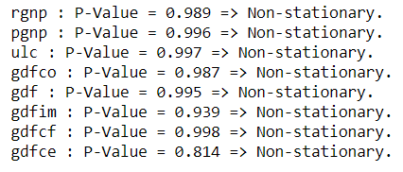
Stationary Test
As VectorARIMA requires time series to be stationary, we will use Augmented Dickey-Fuller Test (ADF Test) to check the stationary of each variable in the dataset.
If the stationarity is not achieved, we need to make the data stationary, such as eliminating the trend and seasonality by differencing and seasonal decomposition.

Slide 18
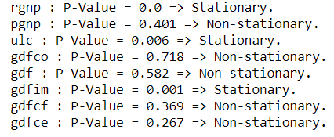
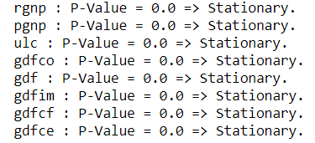
From the results above, we could see none of these variables is stationary. Let us use the differencing method to make them stationary.
Let us do the second differencing:

Slide 19
Parameter values for a Vector ARIMA model
D: order of seasonal differencing.
P: order of the seasonal autoregressive component.
Q: order of the seasonal moving average component.
c: number of exogenous variables (variables that are not part of the time series but can influence it).
d: order of differencing applied to the time series.
k: number of states used in the state space representation of the model.
nT: total number of observations in the time series.
p: order of the autoregressive component.
q: order of the moving average component.
s: seasonal period of the data.

Slide 20
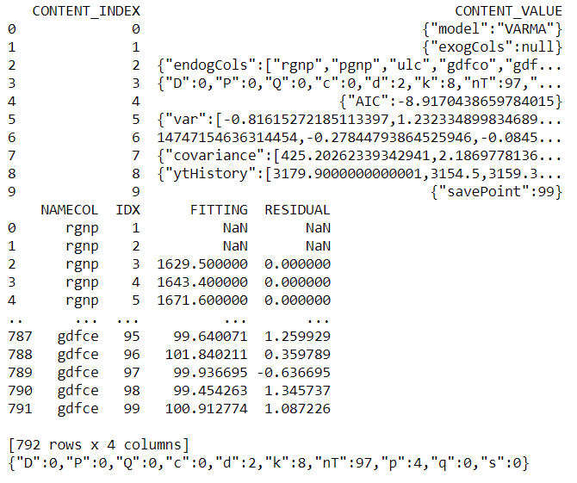
Model Building

Slide 21
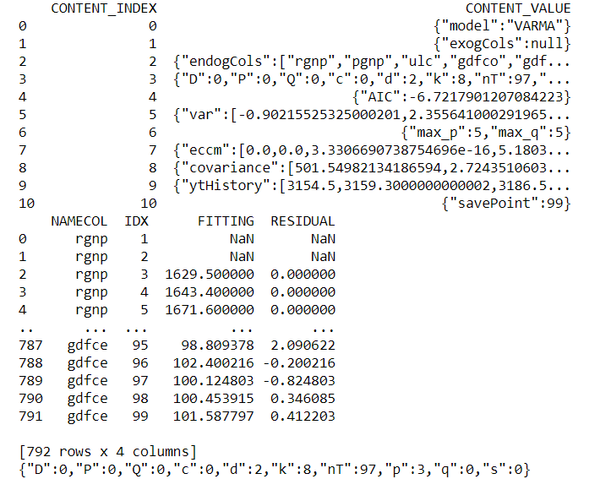
Model Building

Slide 22
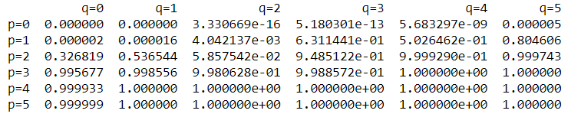
Model Building
From the two results above, a VAR model is selected when the search method is grid search and ECCM and the only difference is the number of AR term. which one is better? Let’s explore these two methods based on content of the eccm which is returned in the vectorArima2.model_.collect()[‘CONTENT_VALUE’][7].
The result of ECCM is shown in a row.
we could tell when p=3 and p=4, q=0, both p-value is greater than 0.95, so both models are good. Another thing we observe is that when p=2 and q=4, the p-value is 0.999 which seems good. However, this model is likely to lead to overfitting.

Slide 23
Grid Search and ECCM
Grid Search: Grid search is a systematic approach to find the optimal combination of model parameters by evaluating multiple models over a predefined grid of parameter values. It involves specifying a range of values for each parameter and then exhaustively evaluating each combination of parameter values to determine the best-fitting model. The evaluation is typically based on a chosen criterion, such as minimizing the Akaike Information Criterion (AIC) or Bayesian Information Criterion (BIC). Grid search helps in selecting the most appropriate values for parameters like p, d, q, P, D, and Q in the VectorARIMA model.
ECCM (Extended Complex Conjugate Method): ECCM is an algorithm used for estimating the parameters of VectorARIMA models. It is particularly useful for estimating complex-valued parameters in VectorARIMA models, which can occur when dealing with time series that involve complex numbers (e.g., in the field of signal processing). The ECCM algorithm extends the Complex Conjugate Method (CCM) to handle the estimation of complex-valued parameters in multivariate time series models. It is an iterative optimization algorithm that estimates the parameters by minimizing the sum of squares of the model residuals.
Grid search helps in identifying the optimal parameter values that result in the best model fit, while ECCM is used for parameter estimation, especially when dealing with complex-valued parameters in multivariate time series models.

Slide 24
Goodness of fit of a model with different p and q in TS
Akaike Information Criterion (AIC): The AIC is a widely used information criterion that measures the trade-off between model fit and complexity. It is calculated as AIC = -2log-likelihood + 2(number of parameters in the model). The AIC penalizes models with more parameters, encouraging parsimony. Lower AIC values indicate better-fitting models.
Bayesian Information Criterion (BIC): The BIC is a similar information criterion to the AIC but places a stronger penalty on model complexity. It is calculated as BIC = -2log-likelihood + log(sample size)(number of parameters in the model). The BIC penalizes models with more parameters more severely than the AIC. As with the AIC, lower BIC values indicate better-fitting models.
Final Prediction Error (FPE): The FPE is an information criterion that focuses on the accuracy of out-of-sample predictions. It is calculated as FPE = (1 + p + q + 1)/(n - p - q - 1) * sum of squared residuals, where n is the sample size. The FPE measures the mean square prediction error and is often used in the context of autoregressive models. Lower FPE values indicate better prediction accuracy.
Hannan-Quinn Information Criterion (HQIC): The HQIC is another information criterion that balances model fit and complexity. It is calculated as HQIC = -2log-likelihood + 2log(log(n))*(number of parameters in the model), where n is the sample size. The HQIC penalizes model complexity, similar to the AIC and BIC, but with a different penalty term. As with the AIC and BIC, lower HQIC values indicate better-fitting models.

Slide 25
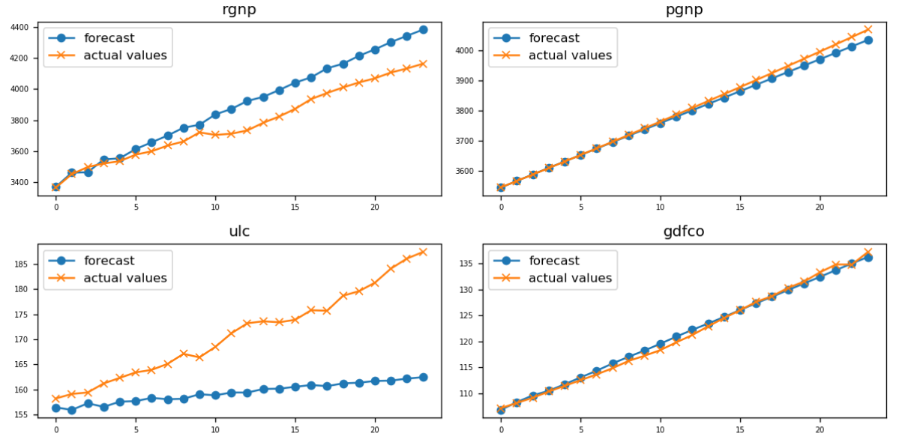
Model Forecasting

Slide 26
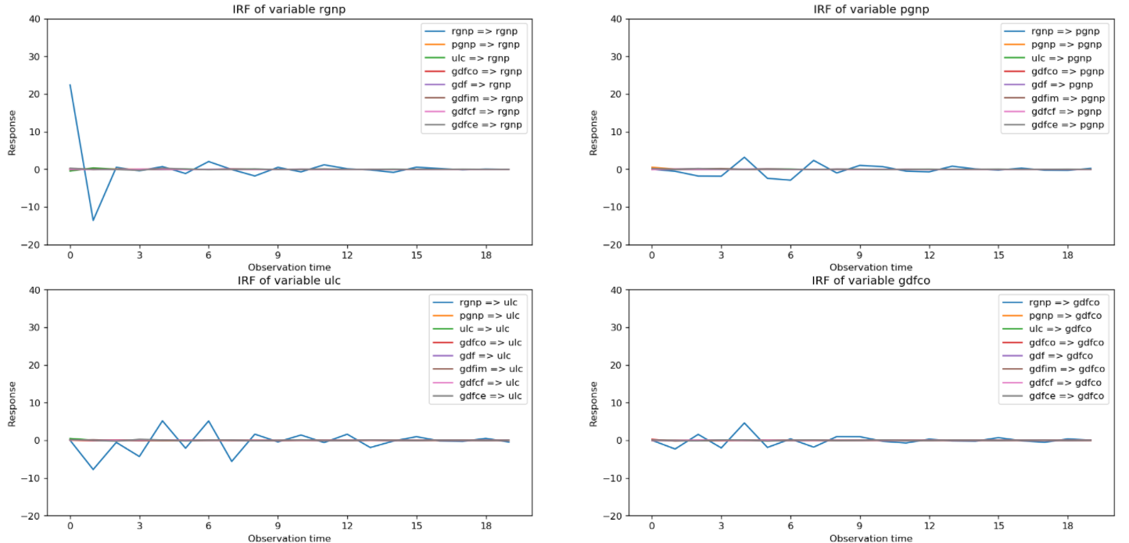
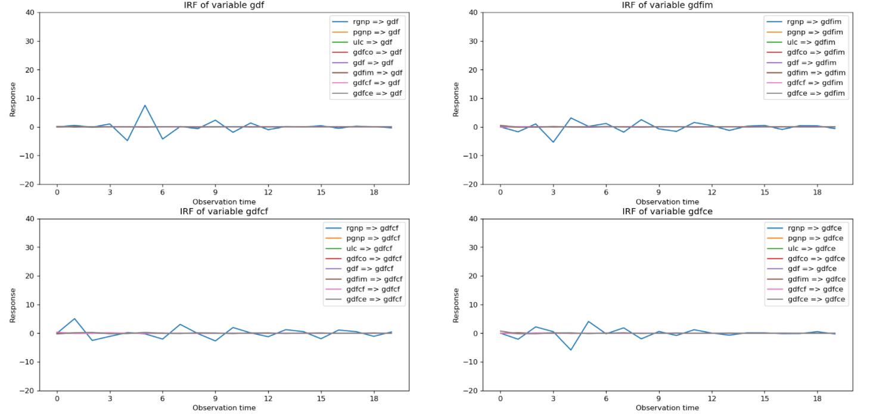
Impulse Response Function
It traces the effects of an innovation shock to one variable on the response of all variables in the system.
After observation, we can see that the eight figures above have something in common.
When the variable ‘rgnp’ is shocked, the responses of other variables fluctuates greatly. On the contrary, when other variables are shocked, the response of all variables almost does not fluctuate and tends to zero. Hence, the variable ‘rgnp’ is very important in the system.

